Slide 1
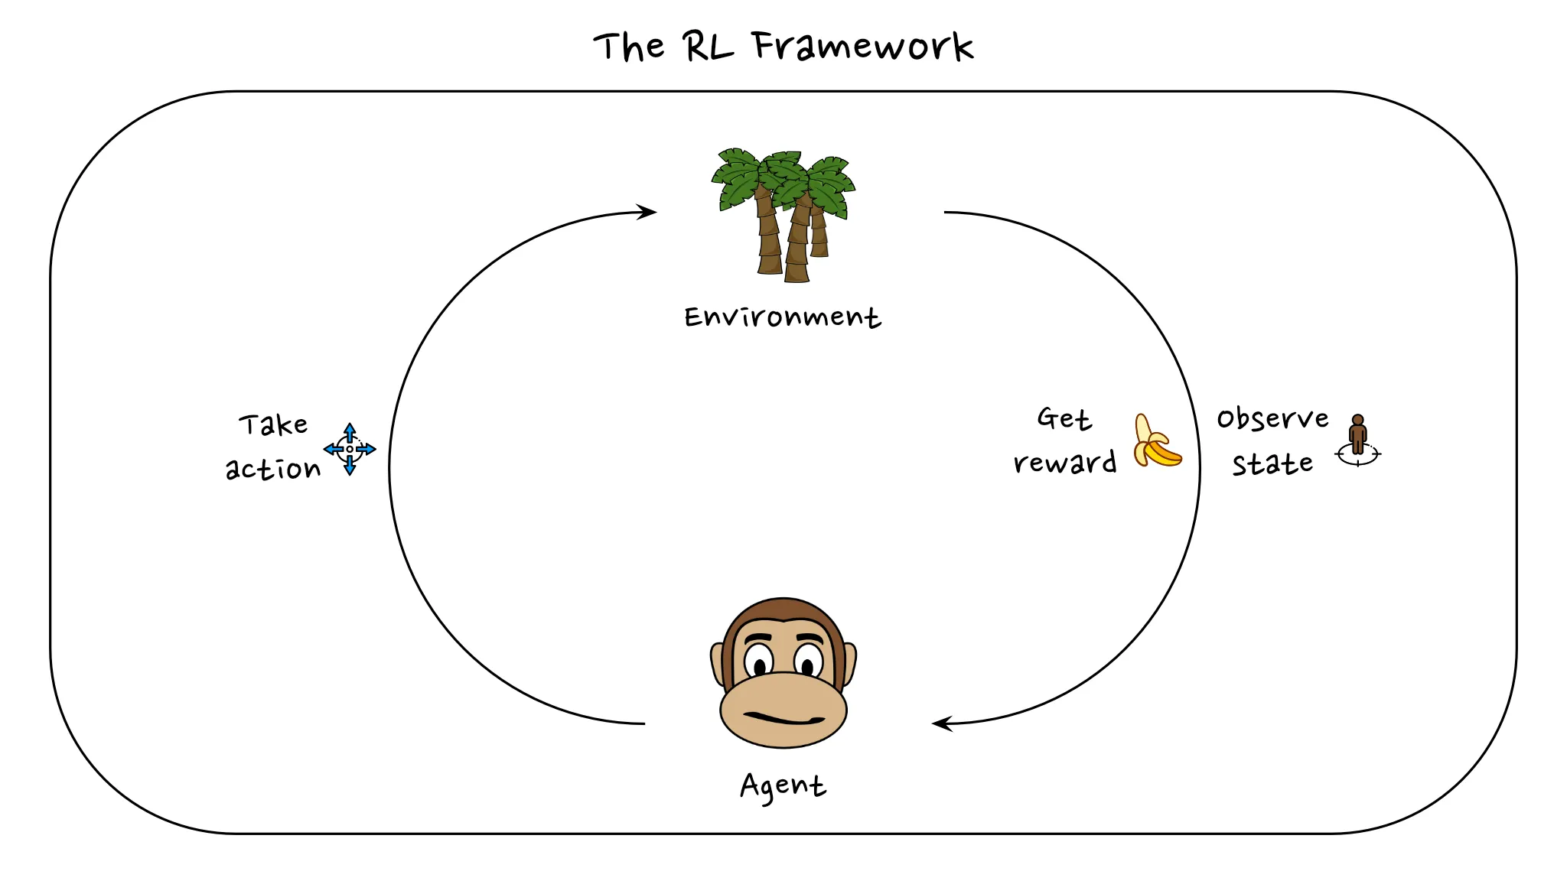
Introduction to Reinforment Learning
By Dr Michael Mollel
Link to the project: GitHub
Link to the model: HF

Slide 2
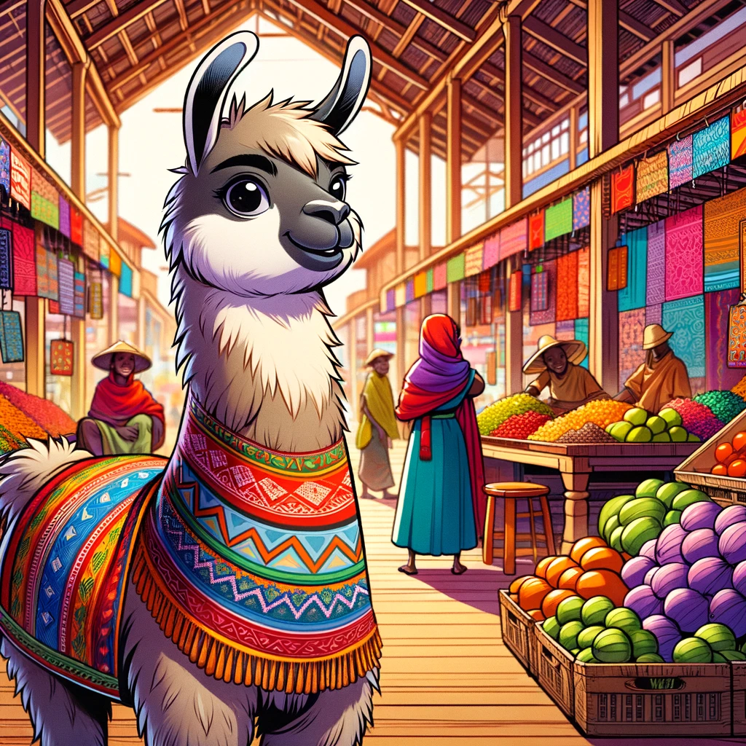
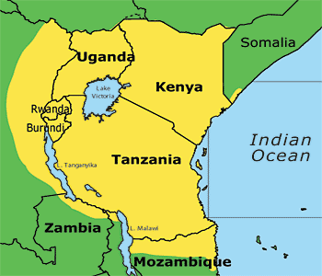
Bridging Language Gaps in AI
Large Language Models (LLMs) like ChatGPT have revolutionized natural language processing (NLP) capabilities
However, these models often struggle with low-resource languages and lack customization options
Swahili, a widely spoken language in East and Southern Africa, has limited language support in current LLMs
Swahili is spoken by more than 150 million people throughout the yellow-highlighted region
Source: https://www.safaricrewtanzania.com/en/language-kiswahili/

Slide 3
Swahili-Llama
Swahili –LLaMA is the Large Language Model (LLM) that addresses the Swahili-speaking population's unique linguistic characteristics and needs.
The main objectives and features of Swahili-Llama include:
Linguistic Inclusivity: Bridging the gap in AI technology by providing a powerful tool for language processing and generation in Swahili, a language spoken by millions but often underrepresented in the digital and AI landscapes.
Open-Source Model: Unlike closed-source Large Language Models, which are restricted in access and customization, Swahili-Llama would ideally be open-source. This allows for greater flexibility, enabling developers, researchers, and users to tailor the model to their needs and contribute to its ongoing improvement.
Versatile Application Support: The model supports various applications, from text generation and sentiment analysis to supervised fine-tuning to different applications.
Customization and Localization: To offer an open-source solution that allows for extensive customization and localization, enabling developers, businesses, and governmental organizations to tailor AI applications to suit specific needs and cultural contexts of Swahili-speaking populations.

Slide 4
Swahili-Llama: Why Swahili LLaMA
Customization at Scale: Explicitly tailored for Swahili, it allows for fine-tuning to meet the unique needs of various applications, from text generation to sentiment analysis.
Open-Source Accessibility: Enables developers in low-resource settings to innovate and develop AI solutions that are genuinely relevant to their communities.
Bridging Language Gaps: By providing a robust tool for Swahili, Swahili-Llama paves the way for greater inclusivity in AI, ensuring that technology serves everyone, irrespective of their primary language.
The Impact: Swahili-Llama is not just a technological breakthrough; it's a step towards democratizing AI, making it accessible and useful for millions of Swahili speakers. It represents a significant leap towards closing the digital divide, fostering local content creation, enhancing educational tools, and improving access to information.

Slide 5
Empowering Local Content and Businesses
Swahili-Llama stands at the forefront of a transformative journey, breaking new ground by localizing AI technology for millions of Swahili speakers. Its development is pivotal in making advanced AI tools accessible and relevant to the East and Southern African communities.
Key Use Cases:
Small Business Support: Swahili-Llama enables small businesses to leverage AI to enhance customer service, conduct market analysis, and create local content that resonates with their target audience.
Education: By providing educational content in Swahili, the model can help overcome language barriers in learning, making education more inclusive and accessible.
Public Services: Government and public service applications can use Swahili-Llama to develop sophisticated applications that ensure security and efficiency since it is open source.

Slide 6
Empowering Local Content and Businesses
Driving Innovation and Inclusivity:
Technological Advancement: Swahili-Llama's sophisticated understanding of Swahili demonstrates a significant leap in AI, particularly in handling the language's nuances more efficiently than ever.
Community Empowerment: This model empowers communities by enhancing digital literacy, fostering local content creation, and enabling a more inclusive digital economy.
The Vision: Our vision with Swahili-Llama is to create a tool and ignite a movement towards more linguistically inclusive technologies. We aim to inspire innovation that respects and uplifts local cultures and languages, making technology a true enabler of progress for all.

